Slide 1
Section 2 (Part 2): Analysis Results Data (ARD) and the ARD-first workflow

Slide 2



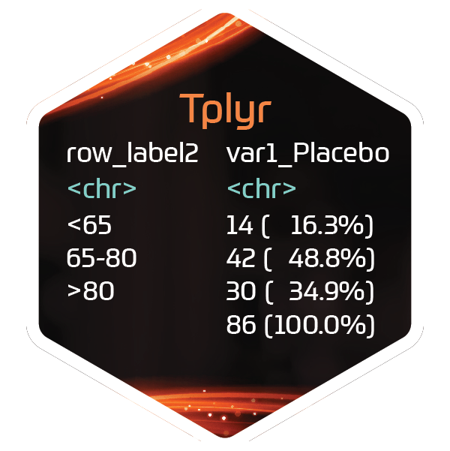






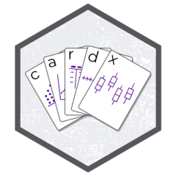





ADaMs
Outputs

Slide 3

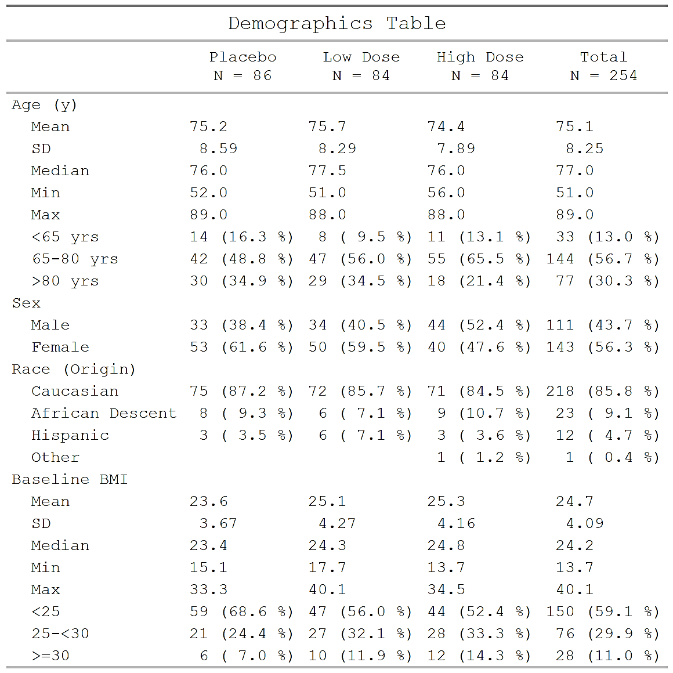


Publication
Presentation
Study Report

Slide 4
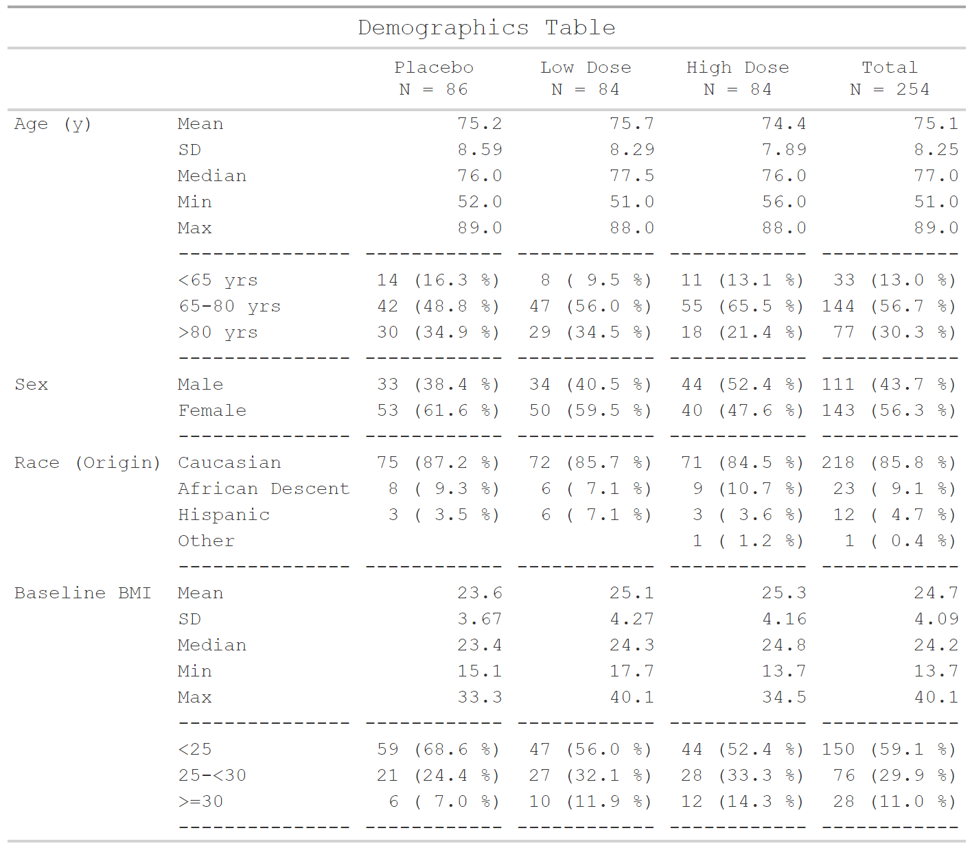
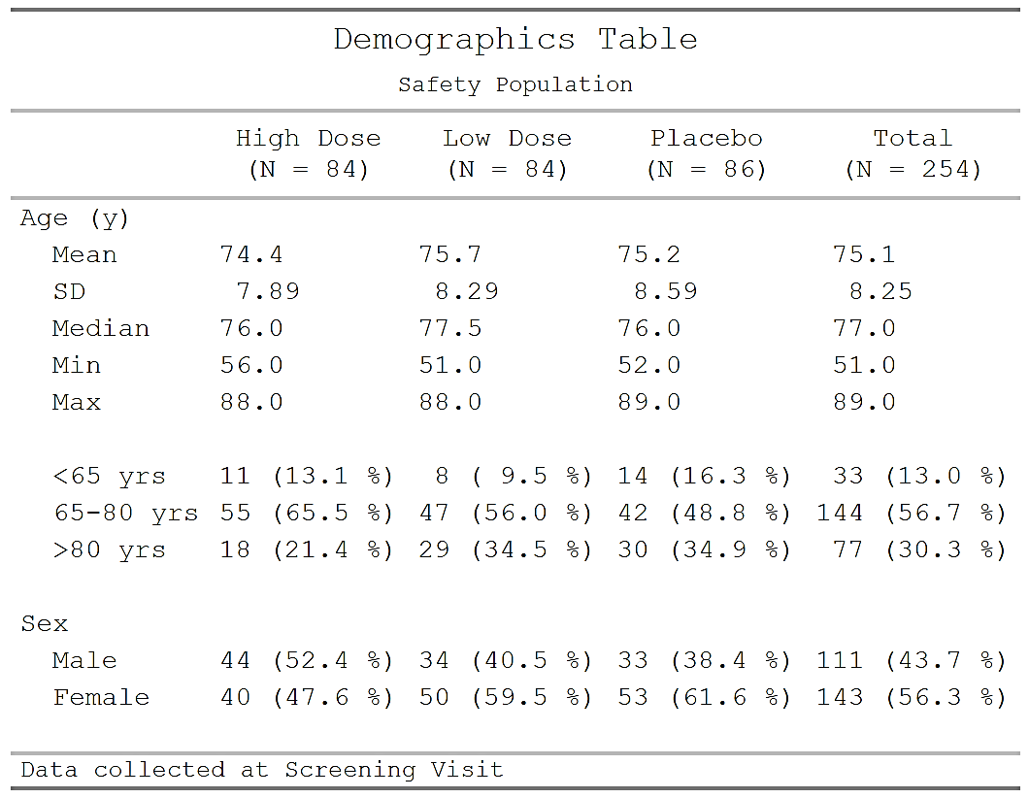
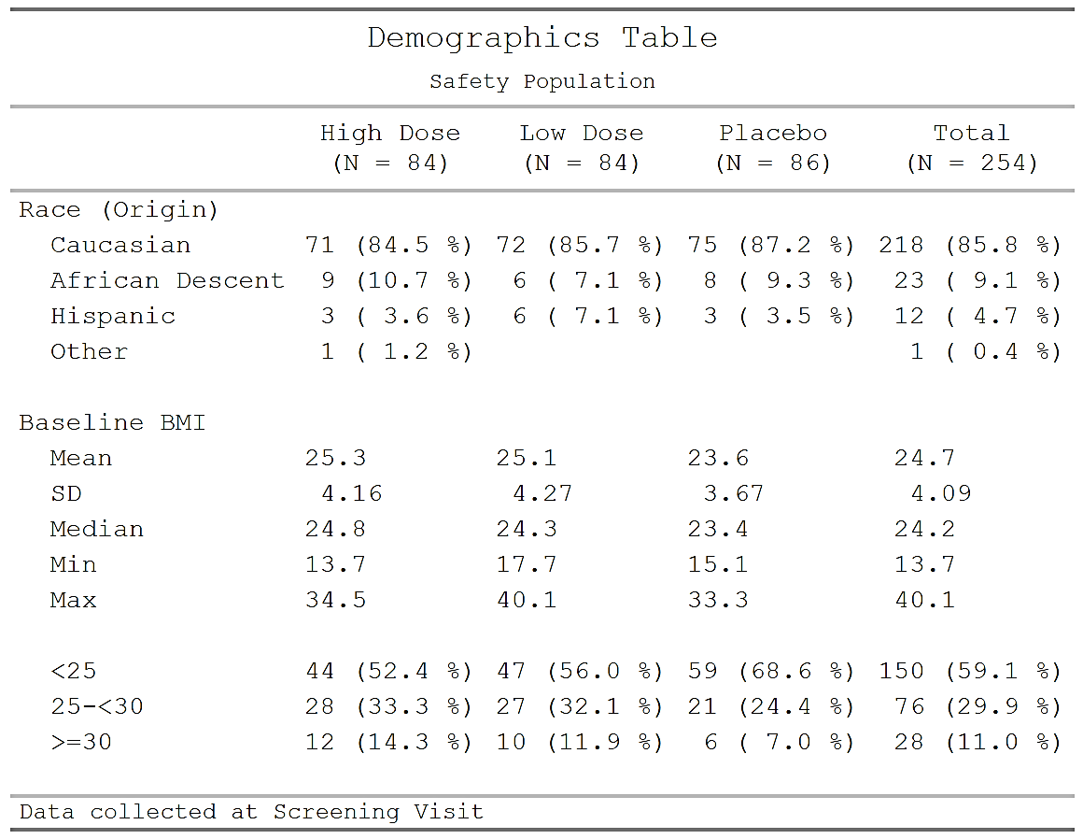
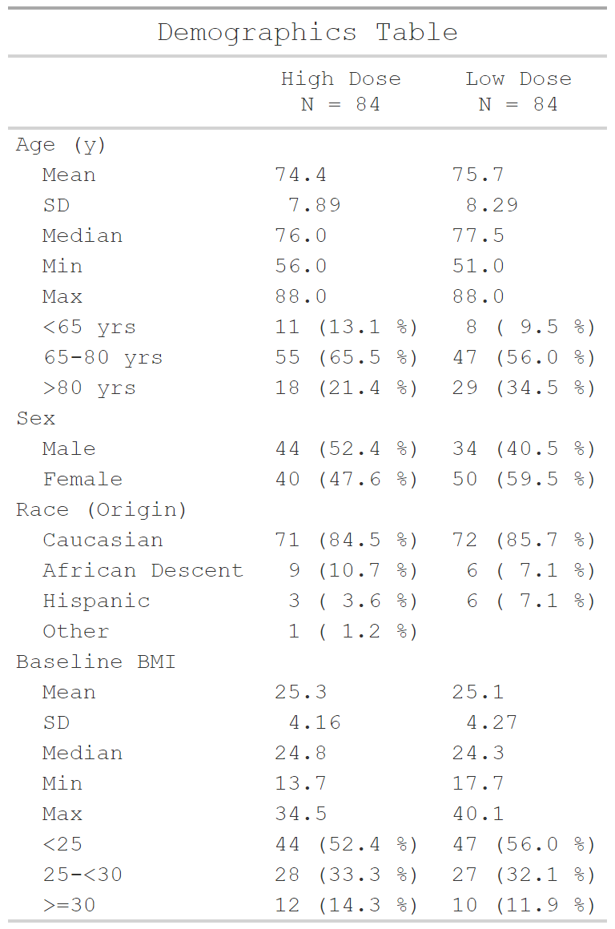
Publication
Presentation
Study Report

Slide 5






Ways of working
ID | AGE | SEX | TRT
100 | 42 | F | Placebo
101 | 60 | M | Placebo
102 | 39 | M | Low
103 | 51 | F | High
104 | 46 | M | Placebo
105 | 35 | F | High
106 | 52 | F | Low
107 | 41 | M | High
… | … | … | …
Analysis
Formatting
Analysis
Formatting

Slide 6

Ways of working
group1 | group1_level | variable | stat_name | stat
ARM | Placebo | Age | n | 86.00
ARM | High | Age | n | 84.00
ARM | Low | Age | n | 84.00
ARM | Total | Age | n | 254.00
ARM | Placebo | Age | mean | 73.56
ARM | High | Age | mean | 74.231
ARM | Low | Age | mean | 71.84
ARM | Total | Age | mean | 9.347
ARM | Placebo | Age | SD | 7.234
… | … | … | … | …
ID | AGE | SEX | TRT
100 | 42 | F | Placebo
101 | 60 | M | Placebo
102 | 39 | M | Low
103 | 51 | F | High
104 | 46 | M | Placebo
105 | 35 | F | High
106 | 52 | F | Low
107 | 41 | M | High
… | … | … | …
Notes:
Key features:
Unformatted values
1 value per row
Distinct columns for each grouping variable
Include everything you want to display (particularly labels)

Slide 7
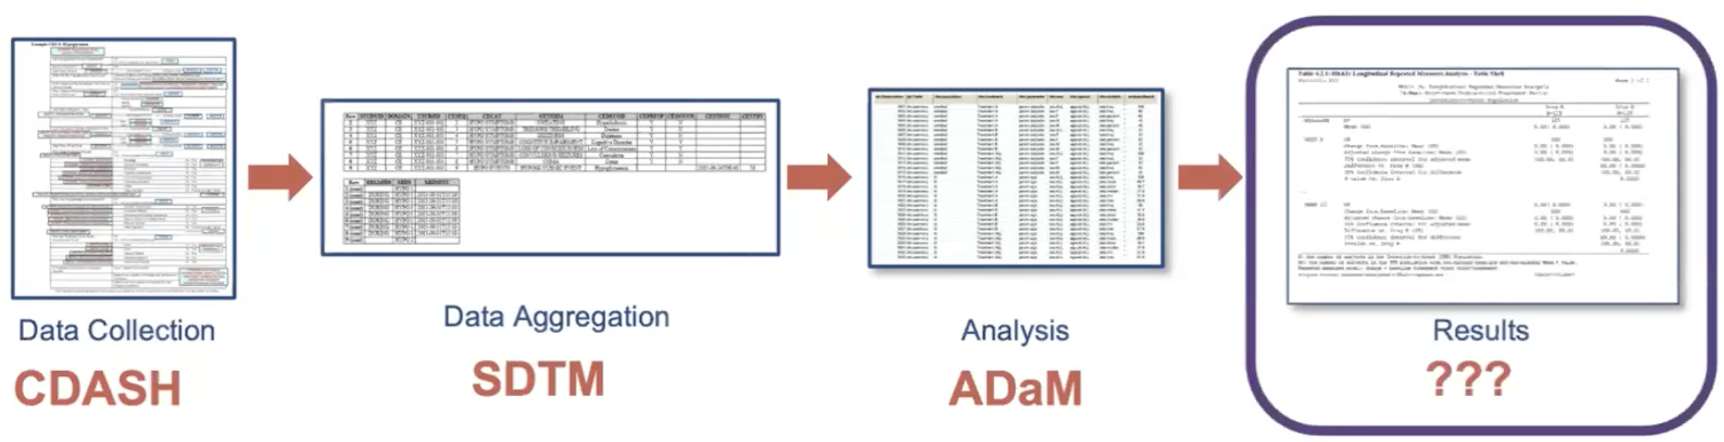
CDISC vision: Analysis Results Standard (ARS)
ARS is an emerging standard for prospectively encoding the statistical analysis reporting pipeline in a machine-readable format
Notes:
Existing guidelines focus on everything up to analysis
ARS meant to fill the gap for analysis results

Slide 8
CDISC vision: Analysis Results Standard (ARS)
Reporting Event (CSR, DSUR, IB, etc.)
Analyses of Interest
Analysis Results Metadata (Technical Specs)
Analysis Programming
Analysis Results Data (ARD)
Outputs/Displays
Logical model that describes analysis results and associated metadata.
Focus on concepts, not layout, e.g. the summary statistics, not how the results are shown in a table.
https://www.cdisc.org/standards/foundational/analysis-results-standard
Notes:
- Emerging standard for **prospectively** encoding statistical analysis reporting pipeline in a machine-readable format.
- Primary objectives are to leverage analysis results metadata to drive the automation of results and support storage, access, processing, traceability and reproducibility of results.

Slide 9
A Few Notes About ARDs
QC is done on raw value
You don’t have to waste time trying to match formatting to match QC
But…
QC will be more sensitive to floating point
QC tolerance will need to be defined
ARD can be saved as a dataset (rds, xpt, etc) or json file

Slide 10
Creating ARDs in R
{cards} Package:
Create CDISC Analysis Result Data Sets
Common functions:
ard_continuous()
ard_categorical()
ard_dichotomous()
ard_missing()
https://insightsengineering.github.io/cards

Slide 11
Creating ARDs in R
{cardx} Package:
Provides additional functions for creating ARDs that rely on statistical packages (such as, {stats}, {mmrm}, {emmeans}, {car}, {survey}, etc.)
+
https://insightsengineering.github.io/cardx

Slide 12
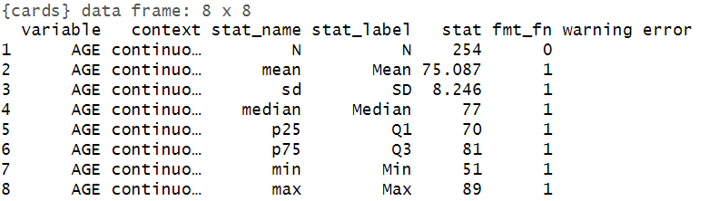
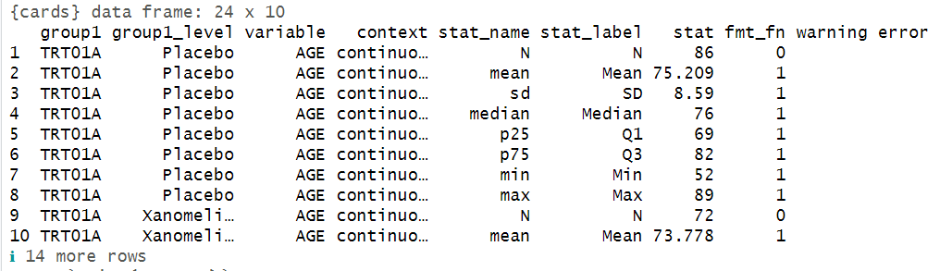
ard_continuous(data = ADSL, variables = AGE)
ard_continuous(data = ADSL, by = TRT01A, variables = AGE)
*by: summary stats are calculated by all combinations, including unobserved factor levels

Slide 13
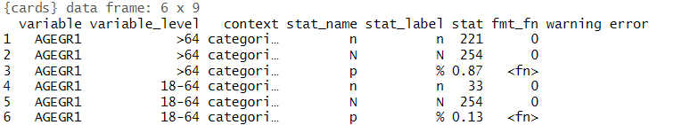
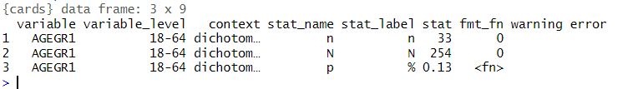
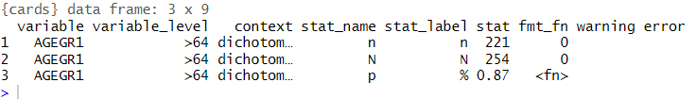
ard_categorical(data = ADSL, variables = AGEGR1)
ard_dichotomous(data = ADSL, variables = AGEGR1)
ard_dichotomous(data = ADSL, variables = AGEGR1, value = ~ “>64”)

Slide 14
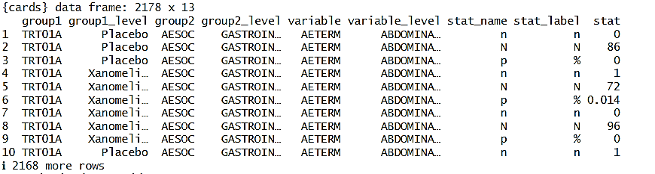
ard_hierarchical(data = ADAE,
by = TRT01A,
variables = c(AESOC, AETERM),
denominator = ADSL)

Slide 15
{cards}: Other useful functions
Summary functions:
ard_hierarchical(): similar to ard_categorical(), but built for nested tabulations, e.g. AE terms within SOC
ard_dichotomous(): similar to ard_categorical(), and tabulates a single value of the variable
ard_complex(): similar to ard_continuous(), but the summary functions can be more complex and accepts other arguments like the full and subsetted (within the by groups) data sets.
ard_missing(): tabulates rates of missingness
Helpers for multiple summaries and wrangling:
ard_stack(): stack multiple ard_*() calls sharing the same `data` and `by` variables
bind_ard(): combine multiple cards summaries
shuffle_ard(): rename variables and shuffle structure to prepare for displays
apply_fmt_fun(): Apply the formatting functions to the raw statistics
Note:
The results from all these functions are entirely compatible with one another, and can be stacked into a single data frame.

Slide 16

Demo time!
Notes:
Import the ADaM adsl data
Calculate continuous/categorical summaries for age (AGE) and age group (AGEGR1) by treatment (TRT01A)
Demonstrate how to modify the statistic argument
Explore ard_stack() as an alternative to individual calls
Explore options like .overall and .total_n

Slide 17
Your turn! Open 02-ard_exercise.R Continue computing demographic summaries using {cards}
Compute continuous summaries for age, BMI, height, and weight by treatment
Compute categorical summaries for age group, sex, race, and ethnicity by treatment
Since sex is actually dichotomous, change it to a dichotomous summary (values for “F” only)
Modify your code from part A. to compute a subset of the continuous summaries (just mean, sd, median, q1, and q3)
Perform all of the summaries in a single `ard_stack` call, including:
Summaries by treatment as performed above
Overall summaries for all variables
Total N

Slide 18
Bonus Exercises: 03-ard_bonus.R
Bonus #1: AE ARD
Calculate the number and percentage of *unique* subjects with any AE, by treatment group and severity
Calculate the number and percentage of *unique* subjects with at least one AE by system organ class, by treatment group and severity
Calculate the number and percentage of *unique* subjects with at least one AE by preferred term nested within system organ class, by treatment group and severity
Calculate population Ns for each treatment group
Combine results into a single cards object, keeping the original order
Bonus #2: statistical testing using cardx
Use {cardx} to test the difference in AGE between High Dose and Placebo groups (hint: use `ard_stats_t_test`)
B. Use {cardx} to test the difference in SEX between treatment groups (hint: use `ard_stats_chisq_test`)

